Slide 1
CC Usability testing results
May 19, 2017

Slide 2
Methods
Health coaches gave feedback on several design options
i.e. 2 versions of note-taking designs, 2 versions of navigational structures
General task completion time and process was noted

Slide 3
Summary
The current system can reduce coaches’ need of outside documentation with a few adjustments to content organization (stability of system assumed)
The system can better support larger call volumes by increasing efficiency: streamlining communication via notes, reducing number of steps in viewing participant information

Slide 4
1. Participant dashboard section
Finding: Although coaches appreciated integration of medication/activity status information within CC, they expressed that they need to have a quick way of obtaining overall view of interactions with participant
Coaches look at additional notes of last call, and if time allows some look at previous calls as well.
“What I do is I actually have an external spreadsheet that we all use where I have my participant’s information…what I love about that spreadsheet is that I can see all of my notes in sort of a dashboard.” (P1)
Recommendation: Provide a summary section in CC where coaches can easily access notes, review participant status (medication, activity) both before and after a call
“[It’s helpful] being able to click on care dashboard [i.e. summary page], and being able to see them all in one page.” (P2)
Allows better scalability, less reliance on external tools: “Instead of the spreadsheet [of additional notes], I could use this.” (P1)

Slide 5
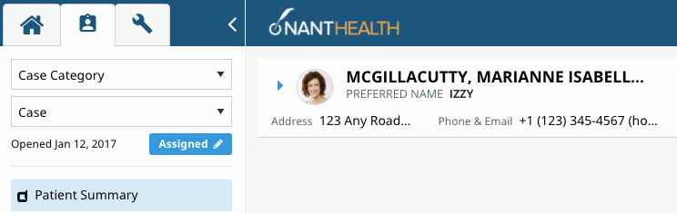
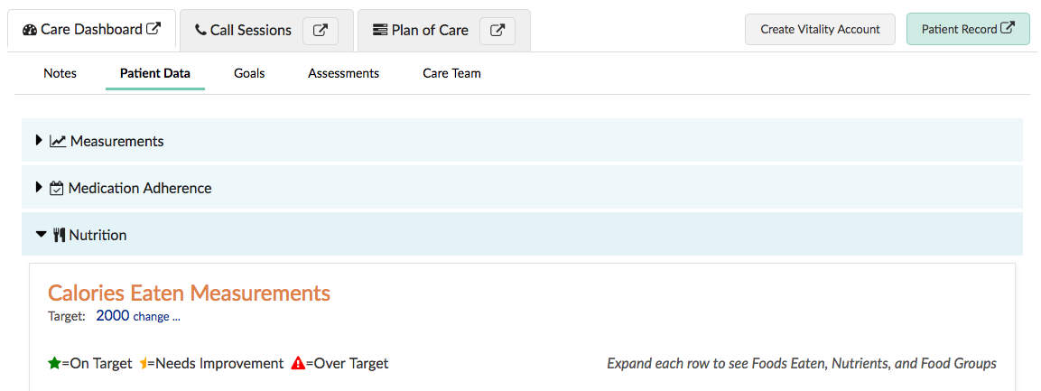
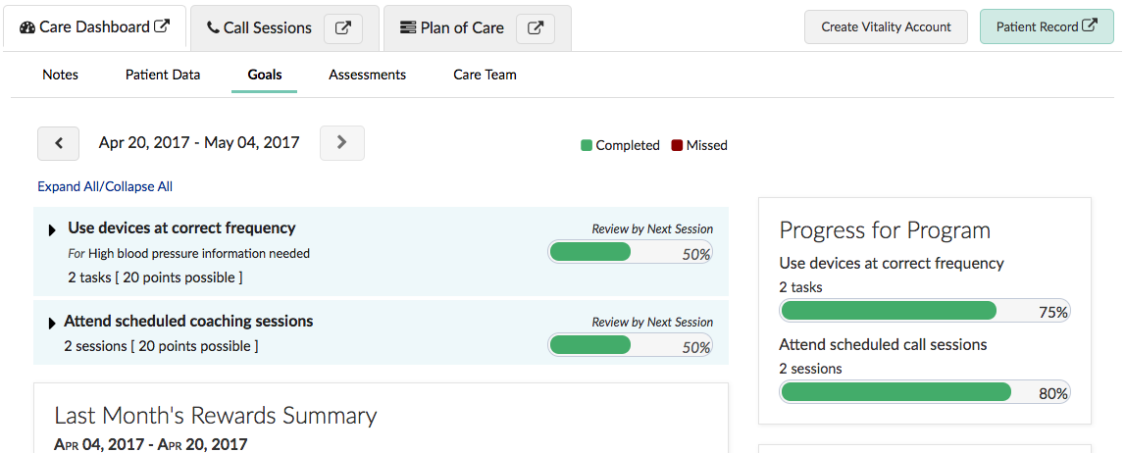
1. Participant dashboard section
Design options
Option 1: Move to Left nav design
Option 2: Rearrange content in current CC design
The pros with this approach may be that while on the call with the participant, coaches are able to access this information (if necessary) without leaving the current script.

Slide 6
2. Referencing participant info during session
Finding: To reference participant information during a script, coaches have to toggle between the session tab and other tabs within CC, or between steps within the interaction checklist
Recommendation: Allow call sessions to be separately viewed from CC, to decrease number of steps taken during a call.
“To me it would be really useful. Because it wouldn't interrupt my flow. So I would be able to be within the call and doing my session.” (P1)
“If there's anything you want to reference back, like see if they have certain goals, you can dive into the coaching session right away, break the ice with how they've done with their goal. You can look at it and not have to scroll on different pages and click on different tabs. Makes the coaching session a bit more efficient.” (P2)
Design options
Option 1: Have individual Sessions pop up as a separate window, allow referencing of CC during call
Option 2: As planned in initial design, have coaches view Call session list in separate window

Slide 7
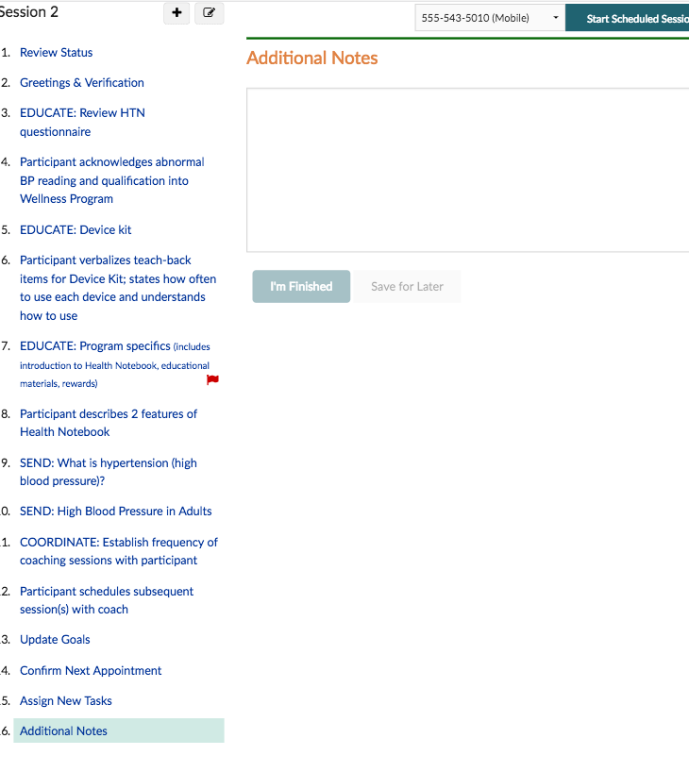
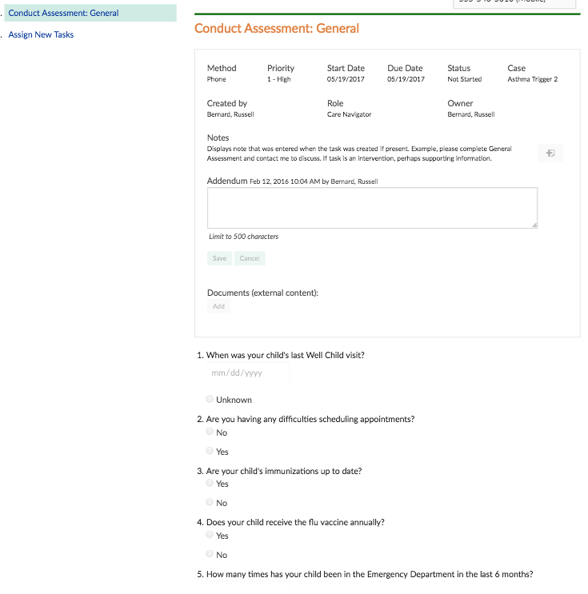
3. Note-taking during a session
Finding: Coaches currently wait until final step in call session before writing any additional notes in CC, meaning they have to take notes in outside documentation when necessary.
For steps that do have notes, coaches have to scroll between the note-taking section and content in order to document any additional content not detailed in their call script.
Call content
Note-taking area
Call content
Note-taking area

Slide 8
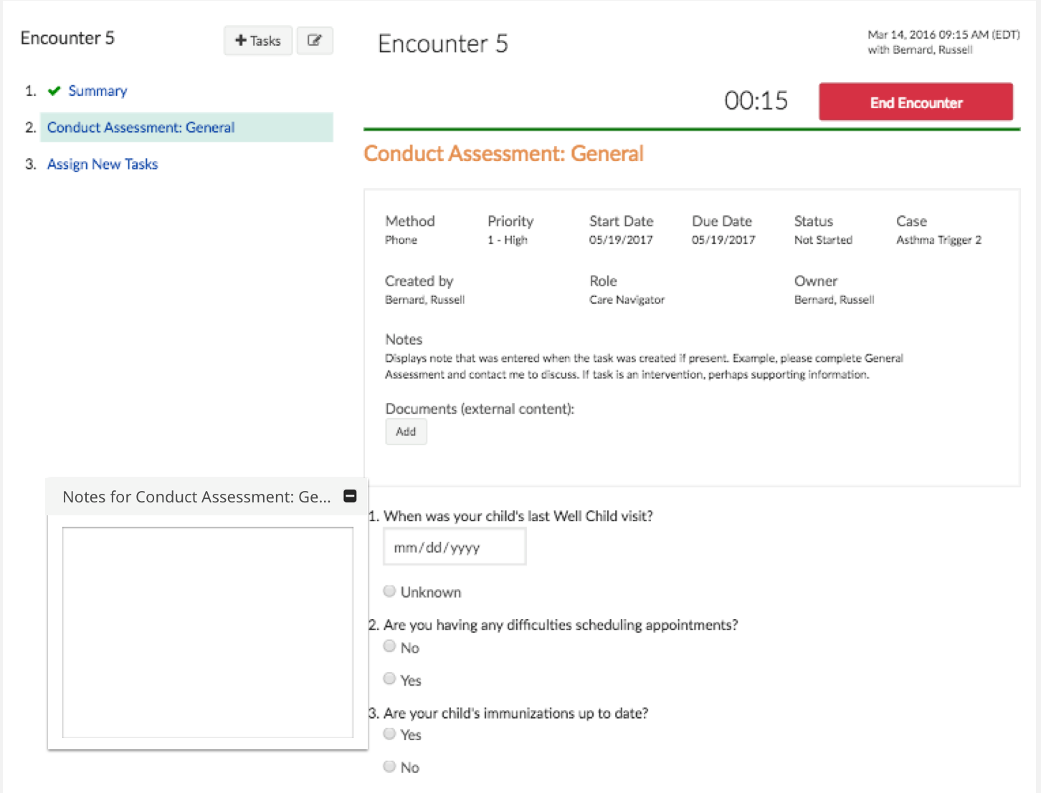
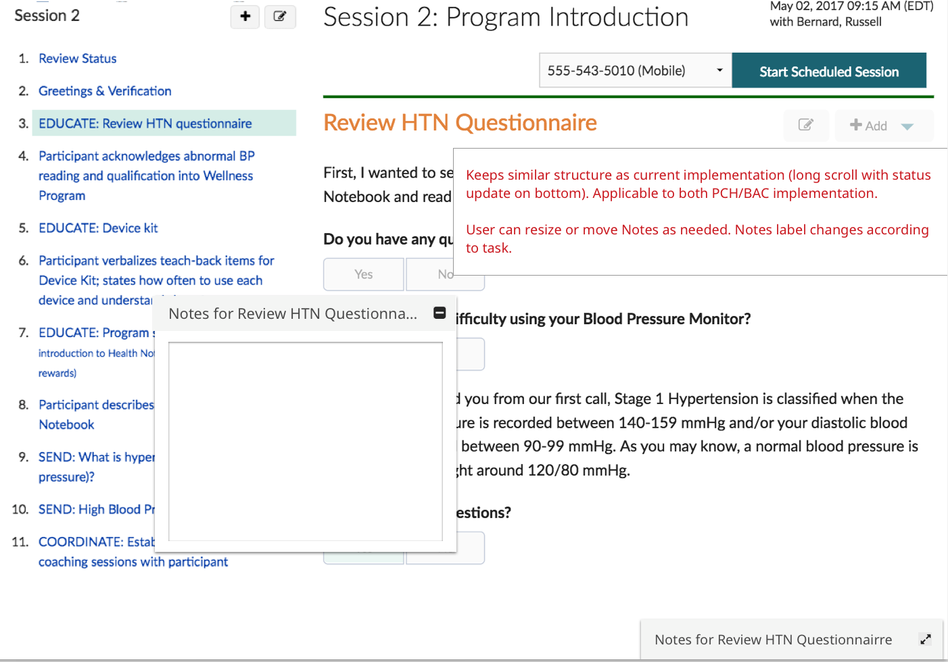
3. Note-taking during a session
Recommendation: Allow notes to be taken per script or care plan component in an easily accessible format, consistent for PCH/BAC.
“I like the fact that if this little notepad could just be open while I'm talking to participant.“ (P1)
Links any free-text note closer with care plan component, rather than entire session
Reduces reliance on outside tools or memory

Slide 9
4. Care Team Notes functionality
Finding: View Session Summary report is helpful for reviewing sessions but coaches expressed the need to quickly review notes only
“Ideally I would like this to be another tab in here. because I do like notes because if you're really rushed [you can look at them]...but this one is great because you don't even have to really click into the call and it shows you all the calls at once.” (P3)
“It'd be great to have all notes in one place. Right now I only put my notes in additional notes section. i don't even use notes in the script itself. Even so I still have to go back and look.” (P1)
Recommendation: Allow the Care Team Notes page to function as a repository of a variety of notes and allow coaches to choose which notes get added (or filter)
“If I were to do it: direct session notes, anything specifically about what happened that day. Additional notes could be any notes that you've had in the past that would help in the next session. External notes would be notes not relevant to the coaching call.” (P2)
“if there's a way to categorize the notes, that'd be fantastic...of course the flagged ones. i think just being able to see certain categories.” (P2)

Slide 10
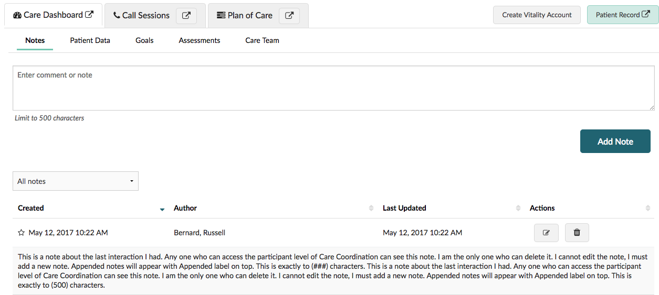
4. Care Team Notes functionality
Allow filtering of notes (i.e. direct session notes, additional notes, external notes)
Allow marking notes as important

